Slide 1

SRM INSTITUTE OF SCIENCE AND TECHNOLOGY
FACULTY OF ENGINEERING AND TECHNOLOGY
18CSS101J –PROGRAMMING FOE PROBLEM SOLVING
MINI PROJECT REPORT

Slide 2
SUBMITTED BY:
NAME : PATIL HRUTUJA BHAUSAHEB RA2111003011898
NAME : KOLA SAI SINDHU RA2111003011900
NAME : VAINIKA SIRIPURAPU RA2111003011867

Slide 3
TABLE OF CONTENT
Abstract
Problem statement
Description
Objective
Workflow progress
Algorithm
Flowchart
Code
Result
conclusion

Slide 4
abstract
Stone Paper Scissors is a childhood favorite of many, and works similarly on the computer to how it does in person. The player chooses to throw the stone, paper, or scissors, and the computer plays the same on the other side. There is an immediate winner, and the game challenges the player to try to think strategically to try to outsmart the computer.

Slide 5
Problem statement
ALGORITHM
To create a game that allows users to play STONE PAPER SCISSOR with the computer in a neat and convenient manner.
STEP 1: Input V1
STEP 2:Input V2
STEP 3: If (v1 = stone) then
STEP 4: If (v2 = stone) goto draw
STEP 5: If (v2 = paper) goto lost
STEP 6: If (v2 = scissors) goto win

Slide 6
STEP 7: If (v1 = paper) then
STEP 8: If (v2 = stone) goto win
STEP 9:If (v2 = paper) goto draw
STEP 10:If (v2 = scissors) goto lost
STEP 11: If (v1 = scissors) then
STEP 12: If (v2 = stone) goto lost
STEP 13: If (v2 = paper) goto win
STEP 14: If (v2 = scissors) goto draw
STEP 15: // if we got here, something was wrong with input values
STEP 16: print error message; goto exit
STEP 17:draw: print draw message; goto exit
STEP 18: Lost: print lost message; goto exit
STEP 19: win: print win message; goto exit
STEP 20: exit: exit the program

Slide 7
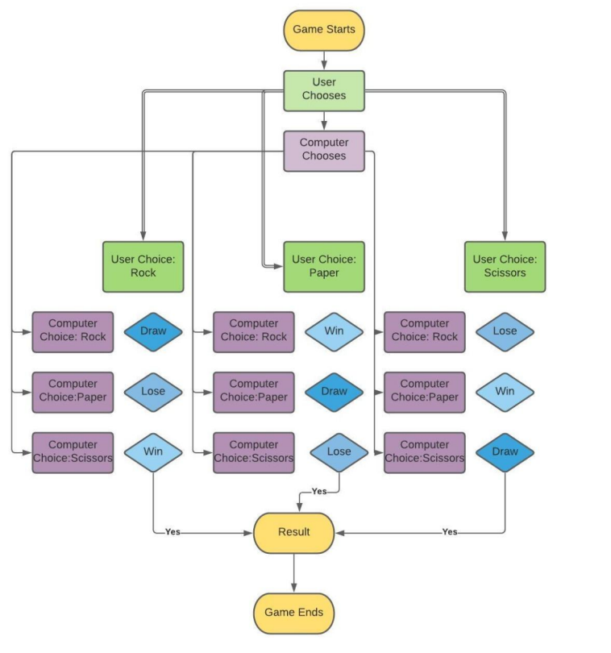
Flow chart

Slide 8
CODE
// C program for the above approach
#include <math.h>
#include <stdio.h>
#include <stdlib.h>
#include <time.h>
// Function to implement the game
int game(char you, char computer)
{
// If both the user and computer
// has chose the same thing
if (you == computer)
return -1;

Slide 9
// If user's choice is stone and
// computer's choice is paper
if (you == 's' && computer == 'p')
return 0;
// If user's choice is paper and
// computer's choice is stone
else if (you == 'p' && computer == 's') return 1;
// If user's choice is stone and
// computer's choice is scissor
if (you == 's' && computer == 'z')
return 1;

Slide 10
// If user's choice is scissor and
// computer's choice is stone
else if (you == 'z' && computer == 's')
return 0;
// If user's choice is paper and
// computer's choice is scissor
if (you == 'p' && computer == 'z')
return 0;
// If user's choice is scissor and
// computer's choice is paper
else if (you == 'z' && computer == 'p')
return 1;

Slide 11
// Driver Code
int main()
{
// Stores the random number
int n;
char you, computer, result;
// Chooses the random number
// every time
srand(time(NULL));
// Make the random number less
// than 100, divided it by 100
n = rand() % 100;

Slide 12
// Using simple probability 100 is
// roughly divided among stone,
// paper, and scissor
if (n < 33)
// s is denoting Stone
computer = 's';
else if (n > 33 && n < 66)
// p is denoting Paper
computer = 'p';
// z is denoting Scissor
else
computer = 'z';

Slide 13
printf("\n\n\n\n\t\t\t\tEnter s for STONE, p for PAPER and z for
SCISSOR\n\t\t\t\t\t\t\t");
// input from the user
scanf("%c", &you);
// Function Call to play the game
result = game(you, computer);
if (result == -1) {
printf("\n\n\t\t\t\tGame Draw!\n");
}
else if (result == 1) {

Slide 14
else if (result == 1) {
printf("\n\n\t\t\t\tWow! You have won the game!\n");
}
else {
printf("\n\n\t\t\t\tOh! You have lost the game!\n");
}
printf("\t\t\t\tYOu choose : %c and Computer choose : %c\n",you,
computer);
return 0;
}

Slide 15
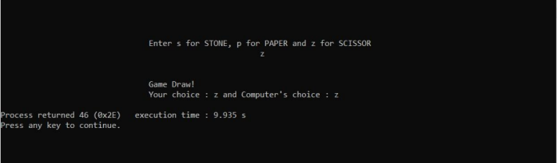
OUTPUT

Slide 16

RESULT
Our project Stone Paper Scissor provides easy access to a formatted game. Our project has succeeded in managing the data and providing the best output.
Stone Paper Scissors has been a hit with all age groups tested. It is a classic game that is enhanced through picture animations. However, in the future, these images could be programmed to look nicer rather than showing as a plain figure window. Also, different versions of the game could be added so the user could choose which version they would like to play

